Slide 1
Team C

Slide 2
Team Members
Ben Bronson
Jake Ellis
Mark Goodwin
Michael Railton
Hien Tran
Ryan Werner

Slide 3
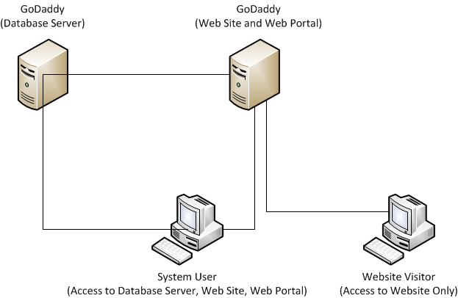
Physical Architecture

Slide 4
Work To Date
Created the database
SQL script to generate the tables and seed the database with a system user.
SQL script to add test data to the database
Created Version Control Repositories
Web portal source code repository.
SQL script repository.
Documentation repository.
Started to Implement the System
Let’s take a look…

Slide 5
Work in Progress
Ben – Show tables page per instructor’s request and researching mail merging.
Jake – Instructor liason, documentation, testing.
Mark – Donation subsystem.
Michael – E-mail subsystem.
Hien – System user subsystem.
Ryan – Event calendar page for the website.

